Slide 1
Full-Scale Flight 1
Atzimba
Avellaneda
First launch was on February 10th.
Record club engagement for a flight test.
Simulated flight
Apogee: 4650-ft.
Main Deploy: 575-ft.

Slide 2
Full-Scale Flight 1 Launch Video
Atzimba
Avellaneda

Slide 3
Full-Scale Flight 1 Recovery Video
Connor Zhou

Slide 4
Full-Scale Test Flight 1 - Data
Connor Zhou
Significant drift occurred, due to 8-min flight time.
Parachutes caught in thermals resulted in different descent rates.

Slide 5
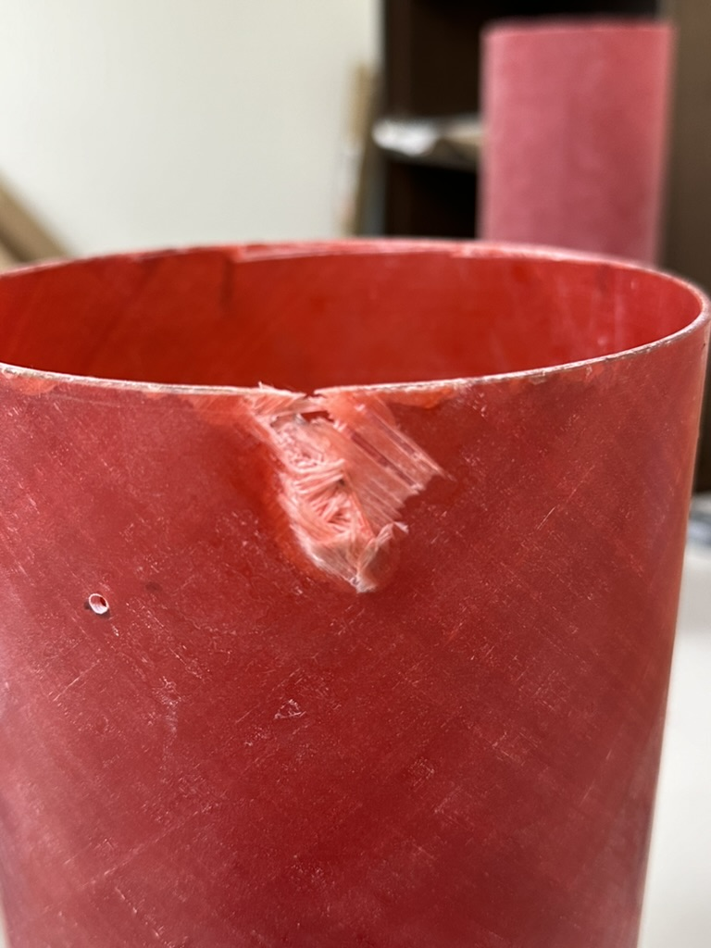
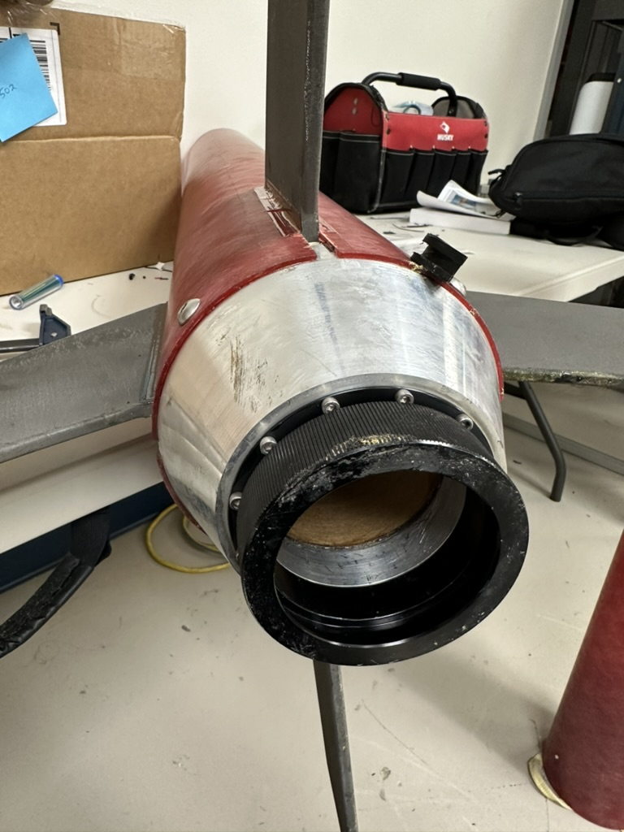
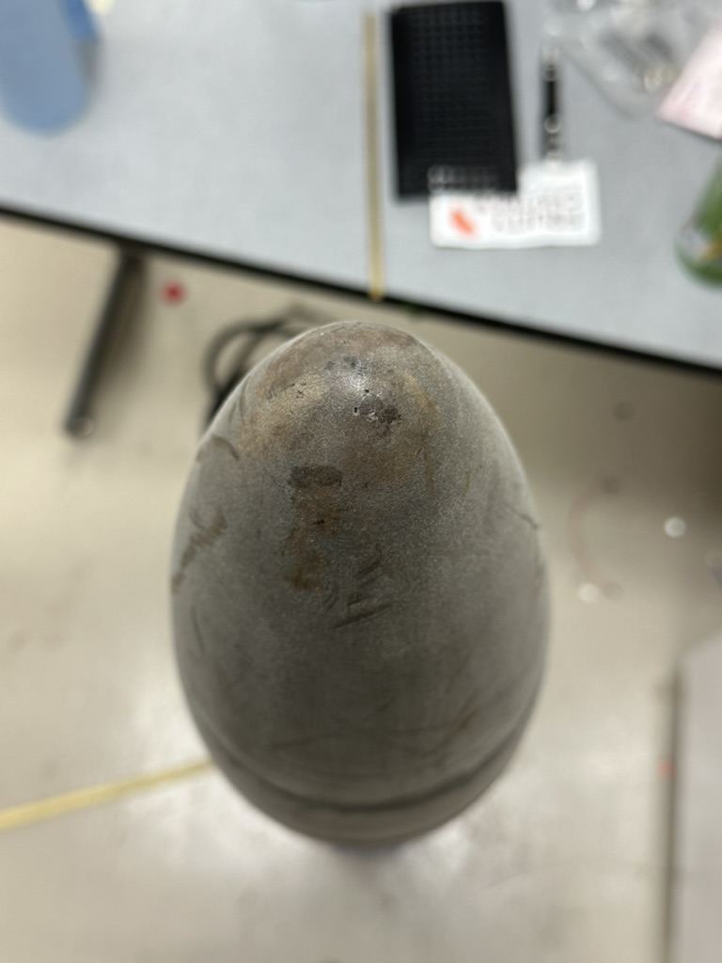
Full-Scale Test Flight 1
Connor Zhou
Flight resulted in two failures:
Major: Main parachute deployed much before target altitude (575-ft).
Resulted in airframe damage from landing in trees.
Minor: Notable disparity between simulated and actual apogee.

